Slide 1
DEPARTMENT OF CSE
COURSE NAME: ADAPTIVE Software
Engineering
COURSE CODE: 22CI2001
Topic:
A Generic Process Model

Slide 2
AIM OF THE SESSION
To familiarize students with the basic concept of Process Models
INSTRUCTIONAL OBJECTIVES
This Session is designed to:
Demonstrate A Generic Process Model
Describe Prescriptive Process models
List out various process models
LEARNING OUTCOMES
At the end of this session, you should be able to:
Define process
Describe Prescriptive Process models
Summarize Prescriptive Process models

Slide 3
AGENDA
A Generic Process Model
Prescriptive Process models
Waterfall Model.
Incremental Process Model.
Evolutionary Process Model.
Prototyping
Spiral Model
4. Concurrent model

Slide 4
Generic Process models

Slide 5
A Generic Process Model
Software process
Process framework
Umbrella activities
framework activity #1
framework activity #2
SE action #1.1
SE action #2.1
task sets | ⎧ ⎨ ⎩ | work tasks work products QA points milestones
task sets | ⎧ ⎨ ⎩ | work tasks work products QA points milestones
SE action #1.2
SE action #2.2
task sets | ⎧ ⎨ ⎩ | work tasks work products QA points milestones
task sets | ⎧ ⎨ ⎩ | work tasks work products QA points milestones
The Generic process model is an abstraction of the software development process. It specifies the stages and order of a process.

Slide 6
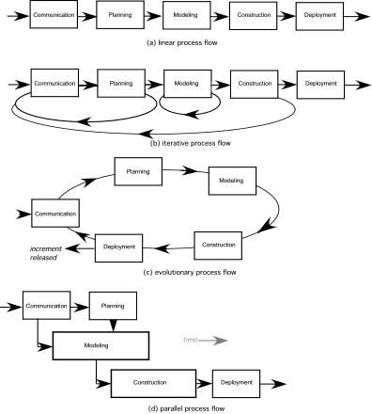
Process Flow: How the framework activities, actions, and tasks occur within each framework activity

Slide 7
Identifying a Task Set
A task set defines the actual work to be done to accomplish the objectives of a software engineering action.
A list of the task to be accomplished
A list of the work products to be produced
A list of the quality assurance filters to be applied

Slide 8
Prescriptive Process models

Slide 9
Prescriptive Process models
The name 'prescriptive' is given because the model prescribes a set of activities, actions, tasks, quality assurance and change the mechanism for every project.
What is the prescriptive process model?
A prescriptive process model is a model that describes "how to do" according to a certain software process system. A prescriptive model prescribes how a new software system should be developed

Slide 10
Prescriptive Process models
Waterfall Model.
Incremental Process Model.
Evolutionary Process Model.
Concurrent model

Slide 11
Prescriptive Process models
Waterfall Model
Oldest software lifecycle model & best understood by upper management
Used when requirements are well understood and risk is low
Workflow is in a linear fashion (i.e., sequential)
Used often with well-defined adaptations or enhancements to current software

Slide 12
Waterfall Model
Communication
Project initiation
Requirement gathering
Planning
Estimating
Scheduling
Tracking
Modeling
Analysis
Design
Construction
Code
Test
Deployment
Delivery
Support
Feedback

Slide 13
Waterfall Model
Problems
Real projects rarely follow sequential flow.
Difficult for customers to state all requirements explicitly and up front
Requires customer patience because a working version of the program doesn't occur until the final phase
Doesn't support iteration, so changes can cause confusion and Leads to “blocking states”.
Useful
Where requirements are fixed and is to proceed to completion in a linear manner.

Slide 14
Cons in Water fall model
Real projects rarely follow the sequential flow that the model proposes
It is often difficult for the customer to state all requirements explicitly
The customer must have patience. A working version of the program(s) will not be available until late in the project time span

Slide 15
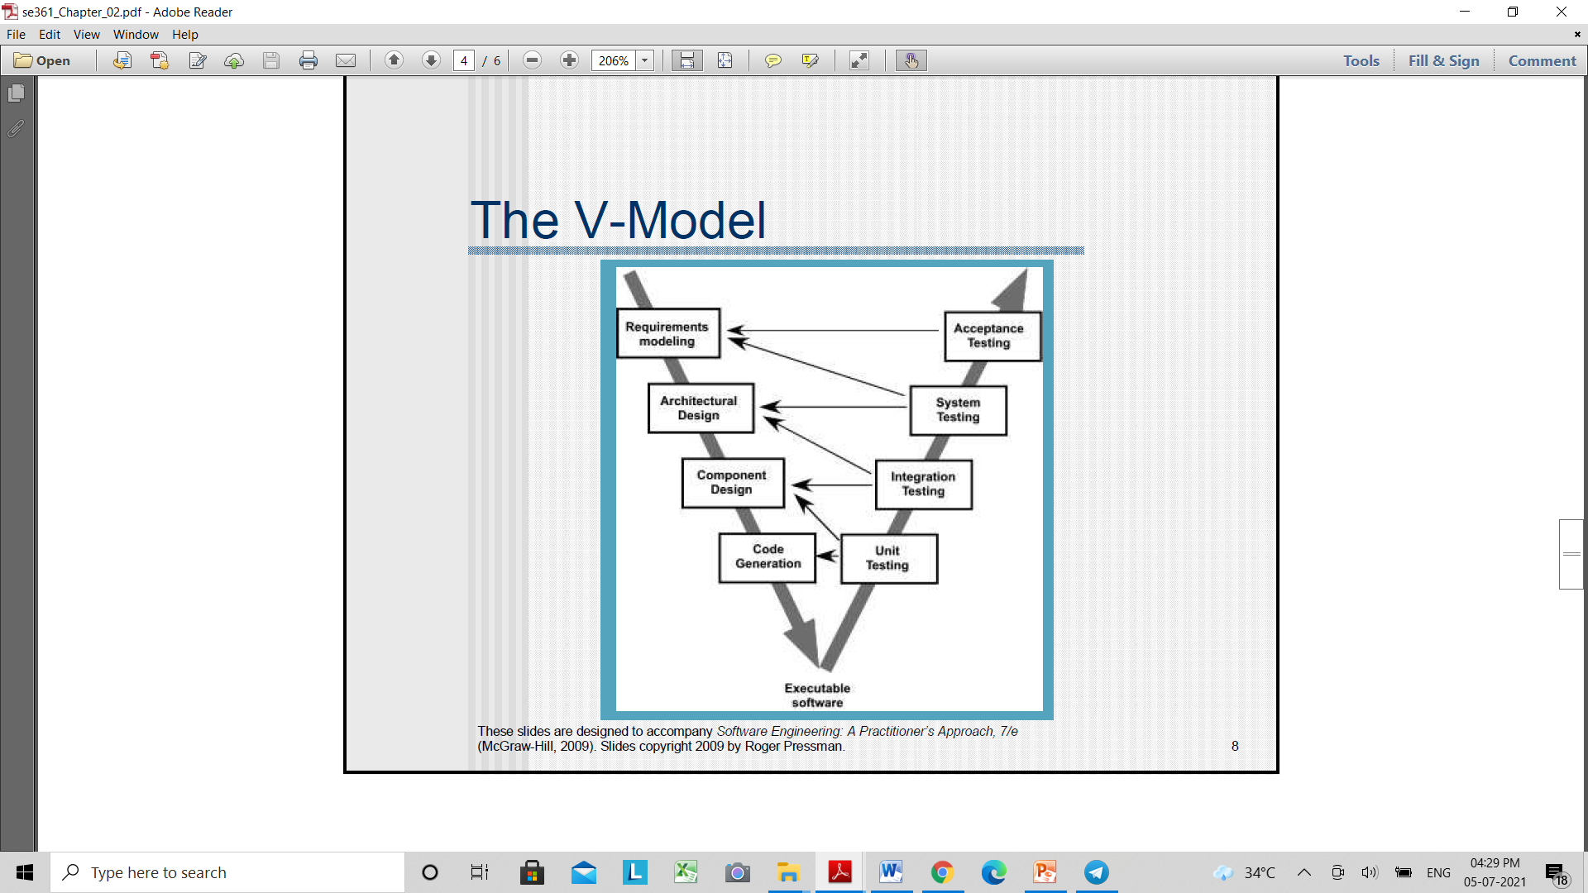
The V-Model

Slide 16
The V-Model
The V-model provides a way of visualizing how verification and validation actions are applied to earlier engineering work
V- model means Verification and Validation model. Just like the waterfall model, the V-Shaped life cycle is a sequential path of execution of processes. Each phase must be completed before the next phase begins

Slide 17
The V-Model
Advantages of V-model:
Simple and easy to use.
Testing activities like planning, and test designing happen well before coding. This saves a lot of time. Hence a higher chance of success over the waterfall model.
Defects are found at an early stage.
Works well for small projects where requirements are easily understood.

Slide 18
The V-Model
Disadvantages of V-model:
Very rigid and least flexible.
Software is developed during the implementation phase, so no early prototypes of the software are produced.
If any changes happen in midway, then the test documents along with requirement documents has to be updated.

Slide 19
When to use the V-model:
The V-shaped model should be used for small to medium-sized projects where requirements are clearly defined and fixed.
The V-Shaped model should be chosen when ample technical resources are available with needed technical expertise.

Slide 20
Prescriptive Process models-Cont:-
Incremental Process Model
Combines elements of linear and parallel process flows.
It delivers a series of releases, called increments that provide progressively more functionality for the customer as each is delivered
The first increment is often a core product.
The plan addresses the modification of the core product to better meet the needs of the customer and the delivery of additional feature and functionality.
It focuses on the delivery of an operational product with each increment.

Slide 21
Incremental Process Model
It is useful when staffing is unavailable for a complete implementation.
Increments can be planned to manage technical risks.
Communication
Software functionality and features
Planning
Modeling (analysis, design)
Construction (code, test)
Deployment ( delivery, feedback)
Delivery of n^{th} Increment
Delivery of 2nd Increment
Delivery of 1st Increment
Project calendar Time

Slide 22
Incremental Process Model
Advantages of the Incremental model:
Generates working software quickly and early during the software life cycle.
This model is more flexible – less costly to change scope and requirements.
It is easier to test and debug during a smaller iteration.
In this model customers can respond to each build.
Lowers initial delivery cost.
Easier to manage risk because risky pieces are identified and handled during its iteration.

Slide 23
Incremental Process Model
Disadvantages of the Incremental model:
Needs good planning and design.
Needs a clear and complete definition of the whole system before it can be broken down and built incrementally.
Total cost is higher than waterfall.

Slide 24
Incremental Process Model
When to use the Incremental model:
This model can be used when the requirements of the complete system are clearly defined and understood.
Major requirements must be defined; however, some details can evolve with time.
There is a need to get a product to the market early.
A new technology is being used

Slide 25

Evolutionary Process Model
Software, like Complex systems evolve over a period of time
-Business and product requirements often change as development proceeds.
- tight market deadlines make completion of a comprehensive software product impossible, but a limited version must be introduced to meet competitive or business pressure
- a set of core product or system requirements is well understood, but the details of product or system extensions have yet to be defined.
Evolutionary models are iterative.
Evolutionary Process Model produce an increasingly more complete version of the software with each iteration.
Specification, development and validation are interleaved.

Slide 26
Prescriptive Process models
Two Types of Evolutionary Process Models
Prototyping
Spiral Model

Slide 27
Evolutionary Process Model
1. Prototyping
It assists you and stakeholders to better understand what is to built when requirements are fuzzy.
Prototyping paradigm
-begins with communication.
- planned quickly and modelling occurs
- quick design focuses on a representation of those aspects of the software that will be visible to end users.
It serves as a mechanism for identifying software requirements.

Slide 28
Prototyping Model(Diagram)
Quick Planning
Communication
Start
Modeling
Quick Design
Deployment,
Delivery,
and Feedback
Construction
Of Prototype

Slide 29
Prototyping Model
Problems
Overall software quality or long-term maintainability is not considered.
As a Software Engineer make implementation compromises in order to get a prototype working quickly.
Useful
The customer get feel for the actual system and developers get to build something immediately
Key here is all the stakeholders should agree that the prototype is built to serve as a mechanism for defining requirements.

Slide 30
Prototyping Model
Advantages of Prototype model:
Users are actively involved in the development
Since in this methodology a working model of the system is provided, the users get a better understanding of the system being developed.
Errors can be detected much earlier.
Quicker user feedback is available leading to better solutions.
Missing functionality can be identified easily
Confusing or difficult functions can be identified

Slide 31
Disadvantages of Prototype model:
Leads to implementing and then repairing way of building systems.
Practically, this methodology may increase the complexity of the system as scope of the system may expand beyond original plans.
Incomplete application may cause application not to be used as the full system was designed
Incomplete or inadequate problem analysis.
When to use Prototype model:
Prototype model should be used when the desired system needs to have a lot of interaction with the end users.
Typically, online systems, web interfaces have a very high amount of interaction with end users, are best suited for Prototype model. It might take a while for a system to be built that allows ease of use and needs minimal training for the end user.

Slide 32
Evolutionary Process Model 2. Spiral development
Originally proposed by Barry Boehm.
It couples the iterative nature of prototyping with the controlled and systematic aspects of water fall model.
Process is represented as a spiral rather than as a sequence of activities with backtracking.
Each loop in the spiral represents a phase in the process.
No fixed phases such as specification or design - loops in the spiral are chosen depending on what is required.
Risks are explicitly assessed and resolved throughout the process.

Slide 33
Spiral model
It is a realistic approach to the development of large-scale systems and software.
The software evolves as the process progresses, the developer and customer better understand and react at each evolutionary level.
It uses prototyping as a risk reduction mechanism.
It demands considerable risk assessment expertise and realise on this expertise for success.

Slide 34
Spiral Model (Diagram)
Planning
Communication
Start
Modeling
Start
Deployment
Construction

Slide 35
Spiral Model
Advantages of Spiral model:
High amount of risk analysis hence, avoidance of Risk is enhanced.
Good for large and mission-critical projects.
Strong approval and documentation control.
Additional Functionality can be added at a later date.
Software is produced early in the software life cycle.

Slide 36
Spiral Model
Disadvantages of Spiral model:
Can be a costly model to use.
Risk analysis requires highly specific expertise.
Project’s success is highly dependent on the risk analysis phase.
Doesn’t work well for smaller projects.

Slide 37
Spiral Model
When to use Spiral model:
When costs and risk evaluation is important
For medium to high-risk projects
Long-term project commitment unwise because of potential changes to economic priorities
Users are unsure of their needs
Requirements are complex

Slide 38
Problems
Do not establish the max. speed of the evolution.
Systems are often poorly structured;
Special skills (e.g. in languages for rapid prototyping) may be required.
Project management and estimation technique do not fit completely.
Applicability
For small or medium-size interactive systems;
For parts of large systems (e.g. the user interface);
For short-lifetime systems.

Slide 39
Concurrent Model
The concurrent development model sometimes called Concurrent Engineering.
It allows team to represent iterative and concurrent elements of any of the process models.
All software engineering activities exist concurrently but reside in different states.
Concurrent modeling defines a series of events that will trigger transitions from state to state for each of the activities.
Concurrent modeling is applicable to all types of software development and provide an accurate picture of the current state of a project.

Slide 40
Concurrent Model cont…
Concurrent models are those models within which the various activities of software development happen at the same time, for faster development and a better outcome. The concurrent model is also referred to as a parallel working model

Slide 41
One element of the concurrent process model
https://www.1000sourcecodes.com/2012/05/software-engineering-concurrent.html
Inactive
State of a s/w eng. activity
Modeling Activity
Under
Development
Awaiting
Changes
Under
Review
Under
Revision
Baselined
Done

Slide 42
SELF-ASSESSMENT QUESTIONS
What Classic life cycle model.
Disadvantages of Incremental Process Model.
Main drawback of Prototyping Model.
Speciality in Spiral Model.
Need of Process models in Software development.
Advantages of Spiral model.
Disadvantages of Spiral model.
Advantages of Evolutionary model.
Disadvantages of Evolutionary model.
Specialty of Concurrent model.
Difference between Waterfall model and Spiral model.

Slide 43
REFERENCES FOR FURTHER LEARNING OF THE SESSION
TEXTBOOKS:
1. Roger S.Pressman, “Software Engineering – A Practitioner’s Approach” 7th Edition, Mc Graw Hill,(2014).
2. Ian Sommerville, “Software Engineering”, Tenth Edition, Pearson Education, (2015).
3. Agile Software Development Ecosystems, Jim Highsmith, Addison Wesley; ISBN: 0201760436; 1st edition
Reference Book
Agile Modelling: Effective Practices for Extreme Programming and the Unified Process Scott Amber John Wiley & Sons; ISBN: 0471202827; 1st edition.
WEB REFERNCES/MOOCS:
https://www.digite.com/kanban/what-is-kanban/
http://www.scaledagileframework.com
https://www.guru99.com/test-driven-development.html
https://junit.org/junit5/

Slide 44

THANK YOU
Team – ADAPTIVE SOFTWARE ENGINEERING

